Slide 1
The Relational Model Model

Slide 2
Enforcing Integrity Constraints
When a relation is modified, if an insert, delete, or update command causes a violation, it is rejected.
INSERT
INTO Students (sid, name, login, age, gpa)
VALUES (53688, ‘Mike’, ‘mike@ee’, 17, 3.4)
INSERT
INTO Students (sid, name, login, age, gpa)
VALUES (null, ‘Mike’, ‘mike@ee’, 17, 3.4)
UPDATE Student S
SET S.sid = 5000
WHERE S.sid = 53688

Slide 3
Enforcing Integrity Constraints(cont)
The impact of foreign key constraints is more complex.
INSERT
INTO Enrolled (cid, grade, studid)
VALUES (‘Hindil01’, ‘B’, 51111)
CREATE TABLE Enrolled (
studid, CHAR(20),
cid CHAR(20),
grade CHAR(10),
PRIMARY KEY (studid, cid),
FOREIGN KEY (studid) REFERENCES Students,
ON DELETE CASCADE,
ON UPDATE NO ACTION )

Slide 4
Transactions and Constraints
Every potentional IC violation is generally checked at the end of each SQL statement execution, although it can be deferred until the end of the transaction executing the statement.
CREATE TABLE Students ( sid, CHAR(20),
…,
honors CHAR(10) NOT NULL,
PRIMARY KEY (sid),
FOREIGN KEY (honors) REFERENCES Courses (cid))
CREATE TABLE Course (cid, CHAR(10),
…,
grader CHAR(20) NOT NULL,
PRIMARY KEY (cid),
FOREIGN KEY (grader) REFERENCES Students (sid))
SET CONSTRAINT ConstraintFoo DEFERRED

Slide 5
Querying Relational Data
A relational database query is a question about the data, and the answer consists of a new relation containing the result. A query language is a specialized language for writing queries. SQL is the most popular commercial query language for a relational DBMS.
SELECT *
FROM Student S
WHERE S.age < 18
sid | name | login | age | gpa
53831 | Madayan | madayan@music | 11 | 1.8
53832 | Guldu | guldu@music | 12 | 2.0

Slide 6
Querying Relational Data (cont)
SELECT S.name, S.login
FROM Student S
WHERE S.age < 18
name | login
Madayan | madayan@music
Guldu | guldu@music

Slide 7
Entity Sets to Tables
CREATE TABLE Employees (
ssn CHAR(11),
name CHAR(30),
lot INTEGER, PRIMARY KEY (ssn)
)
name
ssn
lot
Employees

Slide 8
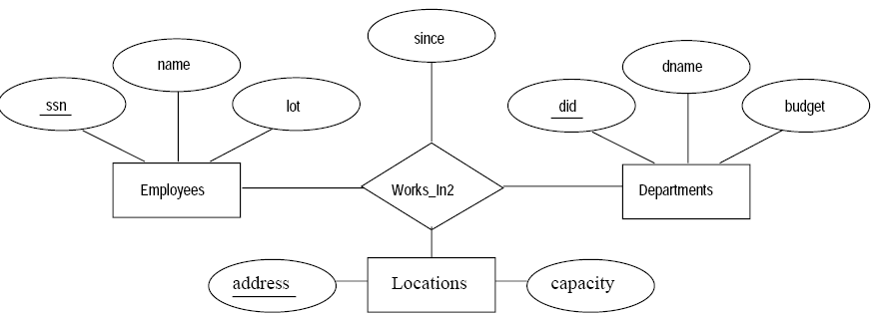
Relationship Sets (without Constraints) to Tables

Slide 9
Relationship Sets (without Constraints) to Tables (cont)
CREATE TABLE Works_In2(
ssn CHAR(11),
did INTEGER,
address CHAR(20),
since DATE,
PRIMARY KEY (ssn, did, address),
FOREIGN KEY (ssn) REFERENCES Employees,
FOREIGN KEY (address) REFERENCES Locations,
FOREIGN KEY (did) REFERENCES Departments,
)

Slide 10
CREATE TABLE Reports_To
(
supervisor_ssn CHAR(11),
subordinate_ssn CHAR(11),
PRIMARY KEY (supervisor_ssn, subordinate_ssn),
FOREIGN KEY (supervisor_ssn) REFERENCES Employees(ssn),
FOREIGN KEY (subordinate_ssn) REFERENCES Employees(ssn)
)
name
ssn
lot
Employees
super-visor
subor-dinate
Reports_To
Notes:
4

Slide 11
Translating Relationship Sets with Key Constraints
CREATE TABLE
Manages (
ssn CHAR(11),
did INTEGER,
since DATE,
PRIMARY KEY(did),
FOREIGN KEY(ssn) REFERENCE Employess,
FOREIGN KEY(did) REFERENCE Departments)
since
name
dname
ssn
lot
did
budget
Manages
Employees
Departments
CREATE TABLE Dept_Mgr (did INTEGER,
dname CHAR(20), budget REAL,
ssn CHAR(11)
since DATE
PRIMARY KEY(did),
FOREIGN KEY(ssn) REFERENCE Employess
Notes:
6

Slide 12
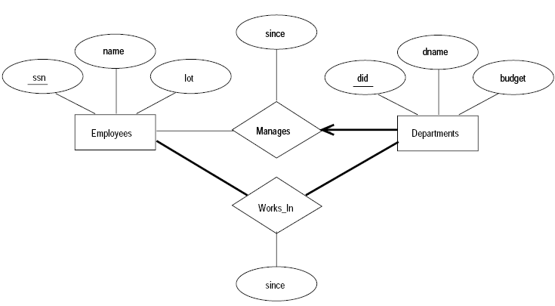
Translating Relationship Sets with Participation Constraints
CREATE TABLE
Dept_Mgr (
did INTEGER,
dname CHAR(20),
budget REAL,
ssn CHAR(11) NOT NULL,
since DATE
PRIMARY KEY(did),
FOREIGN KEY(ssn) REFERENCE Employess,
ON DELETE NO ACTION

Slide 13
Translating Weak Entity Sets
CREATE TABLE Dep_Policy ( pname CHAR(20), age INTEGER,
cost REAL, ssn CHAR(11),
PRIMARY KEY(did),
FOREIGN KEY(ssn) REFERENCE Employess,
ON DELETE CASCADE)
name
ssn
lot
cost
pname
age
Employees
Policy
Dependents
Notes:
10

Slide 14
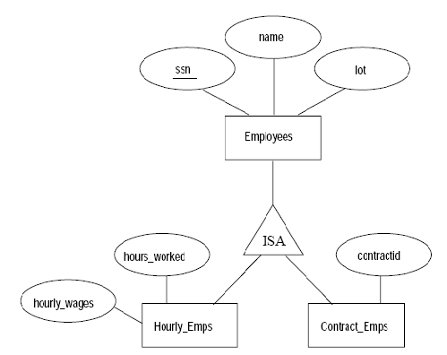
Translating Class Hierarchies
Ex1:
Read the Section 3.5.6.

Slide 15
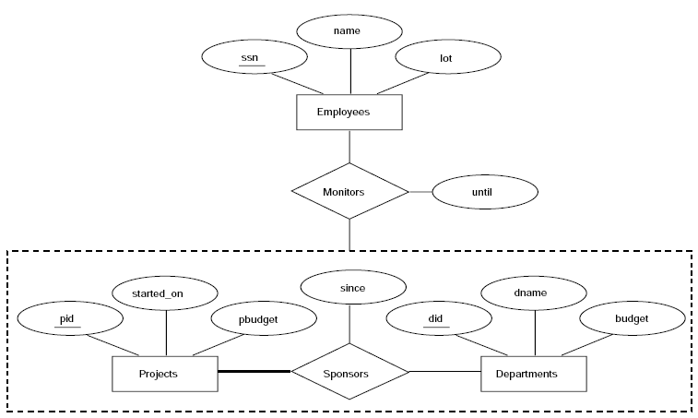
Translating ER Diagrams with Aggregation
Ex2:
Read the Section 3.5.7.

Slide 16
Introduction to Views
A view is a table whose rows are not explicitly stored in the database but are computed as needed from a view definition.
CREATE VIEW B-Students (name, sid, course)
AS SELECT S.sname, S.sid, E.cid
FROM Students S, Enrolled E
WHERE S.sid = E.studid AND E.grad = 'B’
This view can be used just like a base table or explicitly stored table, in defining new quries or views.
name | sid | course
Jones | 53666 | History105
Guldu | 53832 | Reggae203

Slide 17
Views, Data Independence, Security
The view mechanism provides the support for logical data independence in the relational model.
Views are also valuable in the context of security.

Slide 18
Updates on Views
The SQL-92 standard allows updates to be specified only on views that are defined on a single base table using just selection and projection, with no use of aggregate operation. Such views are called updatable views.
SQL:1999 distinguishes between views whose rows can be modified (updatable views) and views into which new rows can be inserted (insertable-into views).
Notes:
6

Slide 19
Destroying/Altering Tables and Views
DROP TABLE
DROP VIEW
ALTER TABLE

